Slide 1
Video Games Mining Under Prof: Jan-Willem van de Meent
Done by:
Sumeet Dubey, Harshdeep Singh, Zhiguang Yu

Slide 2
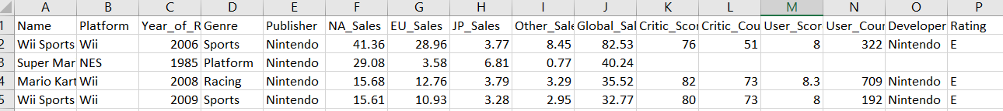
Dataset
Number of games – 16719
13 Genres
582 Publishers
Game reviews with user comments

Slide 3
Milestone 1
Top publishers in the industry
Trends amongst publishers – Shifting Genres
Genres preferred by users / sales across regions for top publishers
Sales across the years for top publishers
Most selling platforms / genres

Slide 4
Milestone 2 / Algorithms
Clustering of game reviews – comparative analysis
Find frequent word-sets in reviews
Predictive rating of game based on training on other games
Clustering – DBSCAN, K-Means
Posterior prediction using Regression
PCA on game reviews

Slide 5
Progress so far

Slide 6
Top Publishers
Current big video game publishers
Nintendo is a clear leader
It is not the top publisher though

Slide 7
Top Publishers
List of companies is the same
EA is the leader in numbers
Activision and Namco Bandai have released almost same number of games

Slide 8
Sales by genres across different regions

Slide 9
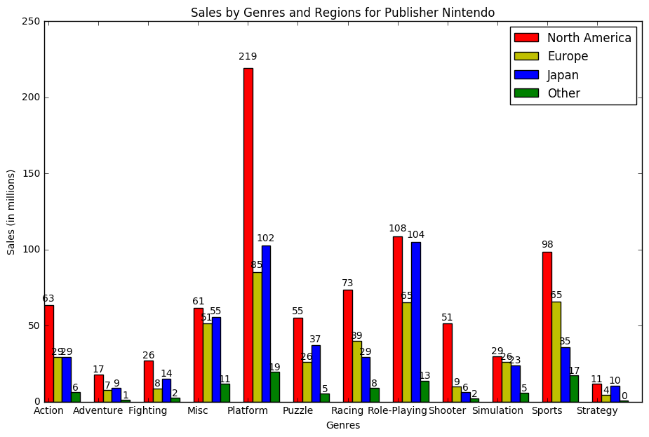
Nintendo
Better sales in Japan (based on sales) as compared to the other publishers
Japan is the 2nd largest market
Consistent sales amongst all genres
Many successful platformers and RPG’s

Slide 10
Two major markets

Slide 11
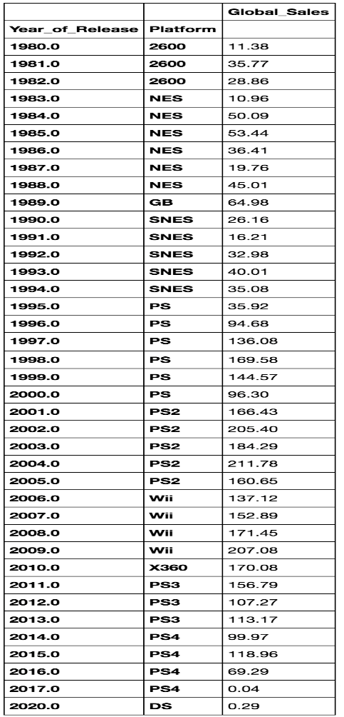
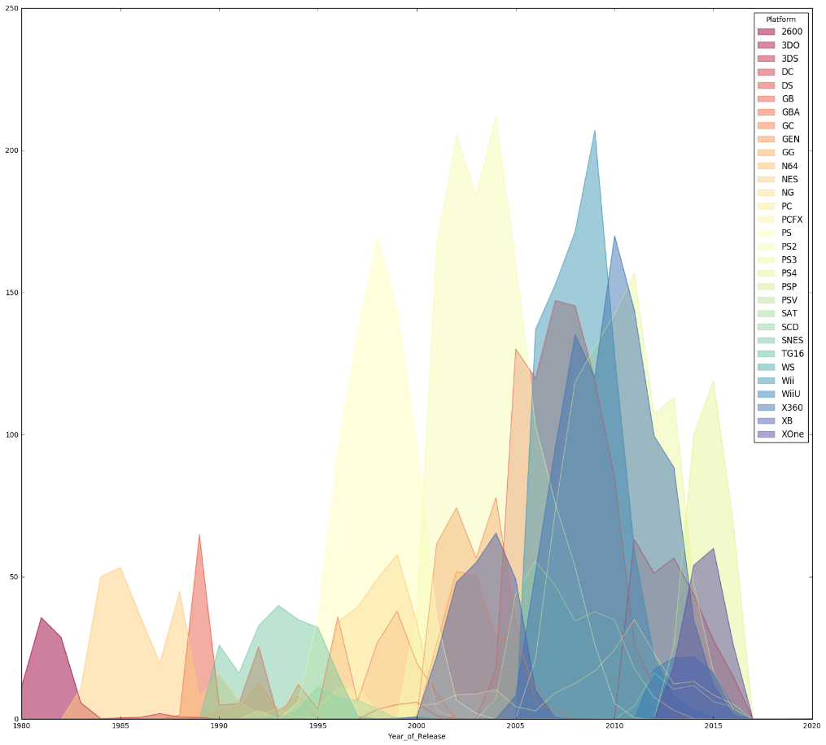
Console Trends

